Slide 1
Multi-approach gravity field models from Swarm GPS data
Mid Term Review
23 March 2018

Slide 2
Agenda
14:00 Introduction (Pieter)
14:10 Management (Joao)
14:20 WP210 GPS data processing algorithms (Adrian)
14:35 WP220 Trade-off between Swarm accelerometer data and
non-gravitational models (Ales)
14:50 WP230 Kinematic baselines for gravity field estimation (Norbert)
15:05 Discussion of future processing strategies (all)
15:20 WP400 Gravity field processing readiness (Adrian, Ales, Norbert, CK)
15:25 WP500 Publication and presentation of project results (Pieter)
15:40 Evaluation of past and future project activities, feedback, points of concern, etc. (Jens, Ciaran)
15:55 Revision of agreements, action points and overview of planned future activities (Joao)
16:10 Conclusion (Pieter)
16:15 Adjourn

Slide 4
WP210 Swarm GPS data pre-processing algorithms
Mid Term Review
23 March 2018
D. Arnold, A. Jäggi
Astronomical Institute of the University of Bern

Slide 5
Introduction
Document currently implemented data screening procedures
Analyze different GPS screening and weighting strategies to mitigate ionosphere-induced artifacts in hl-SST Swarm gravity fields

Slide 6
Test setup
Use different data editing and weighting strategies to generate series of reduced-dynamic and kinematic Swarm orbits.
Validate orbits by SLR
Use kinematic orbits as pseudo-observations for a gravity field recovery using the Celestial Mechanics Approach
Observation sampling: 10s
Max. d/o: 70
A priori field: AIUB-GRACE03S
Validate gravity field solutions in terms of geoid height differences (400 km Gauss filtered) and difference degree amplitudes (w.r.t. AIUB-GRACE03S)
Only show Swarm-A results, but picture for Swarm-C consistent

Slide 7
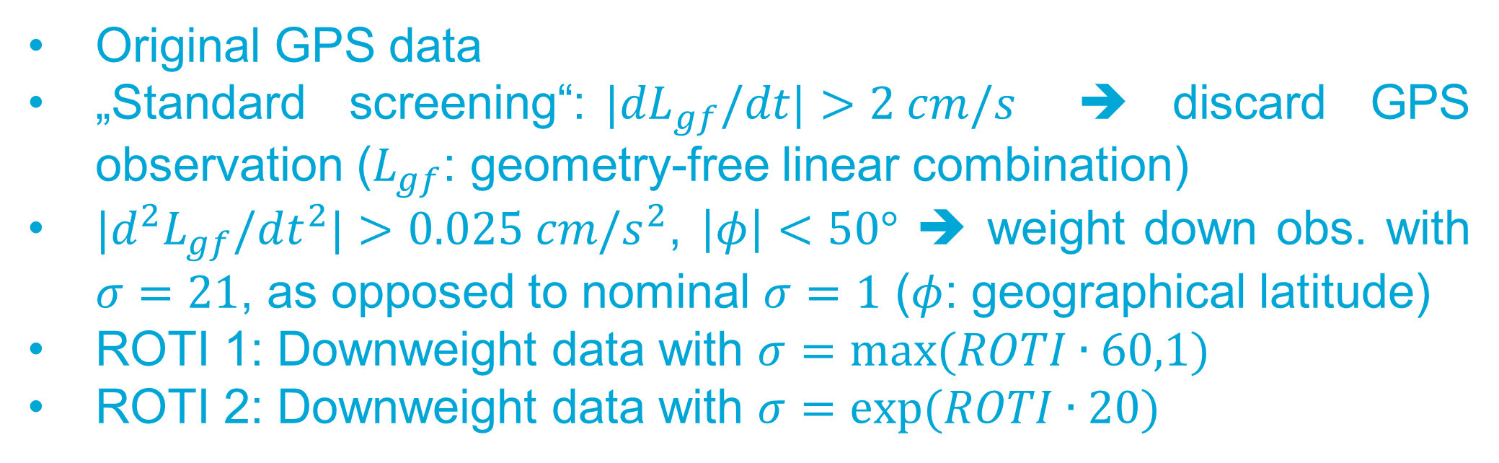
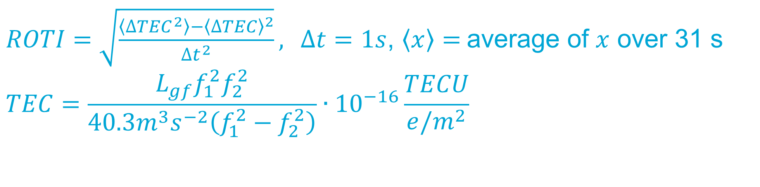
Tests
Original GPS data
„Standard screening“:${|dL}_{gf}/dt|>2 cm/s$ ➔ discard GPS observation ($L_{gf}$: geometry-free linear combination)
${|d}^{2}L_{gf}/dt^{2}|>0.025 cm/s^{2}$, $\left|φ\right|<50°$ ➔ weight down obs. with $σ=21$, as opposed to nominal $σ=1$ ($φ$: geographical latitude)
ROTI 1: Downweight data with $σ=max⁡(ROTI∙60,1)$
ROTI 2: Downweight data with $σ=exp⁡(ROTI∙20)$
$ROTI=\sqrt{\frac{\left\langle ∆{TEC}^{2}\right\rangle −{\left\langle ∆TEC\right\rangle }^{2}}{∆t^{2}}},$ $∆t=1s$, $\left\langle x\right\rangle =$average of $x$ over 31 s
$$TEC=\frac{L_{gf}f_{1}^{2}f_{2}^{2}}{40.3m^{3}s^{−2}\left(f_{1}^{2}−f_{2}^{2}\right)}∙{10}^{−16}\frac{TECU}{e/m^{2}}$$

Slide 8
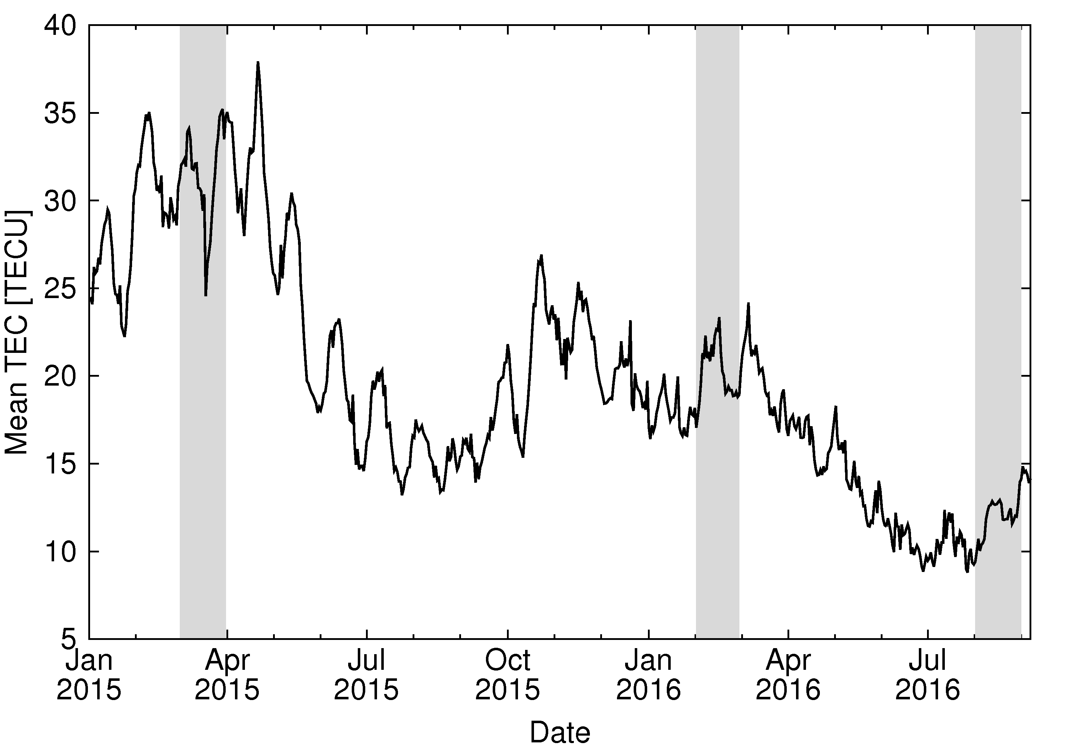
Results
Show results of three different months with different ionospheric activities:

Slide 9
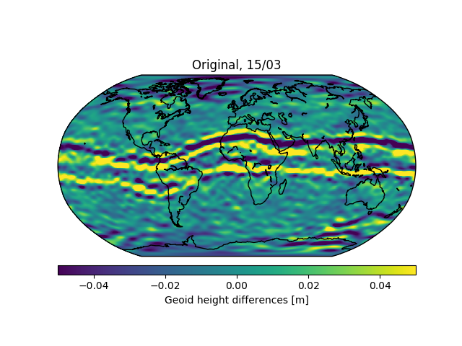
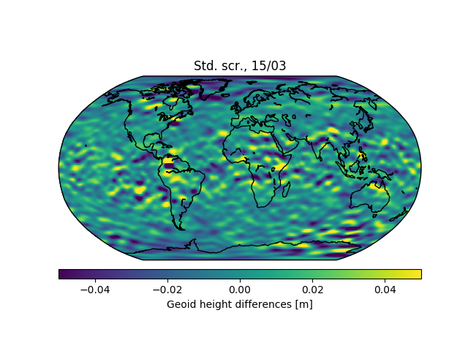
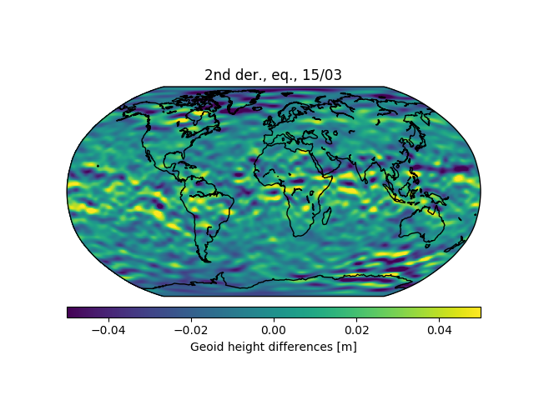
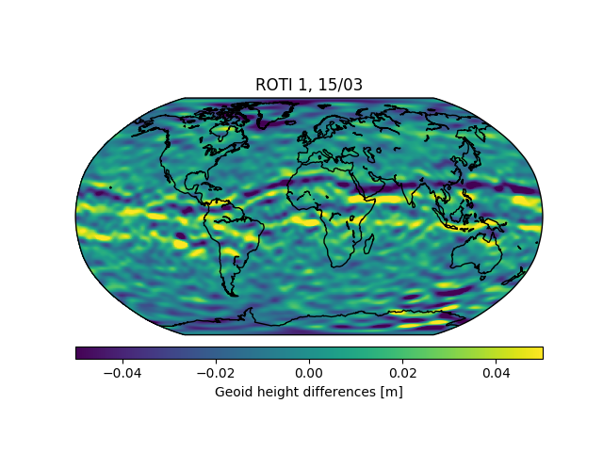
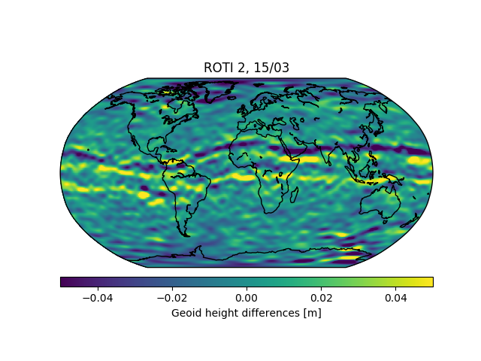
Results
March 2015: High ionospheric activity, prior to tracking loop update
Weighted RMS: 22.0mm
Weighted RMS: 13.8mm
Weighted RMS: 12.9mm
Weighted RMS: 14.3mm
Weighted RMS: 14.1mm

Slide 10
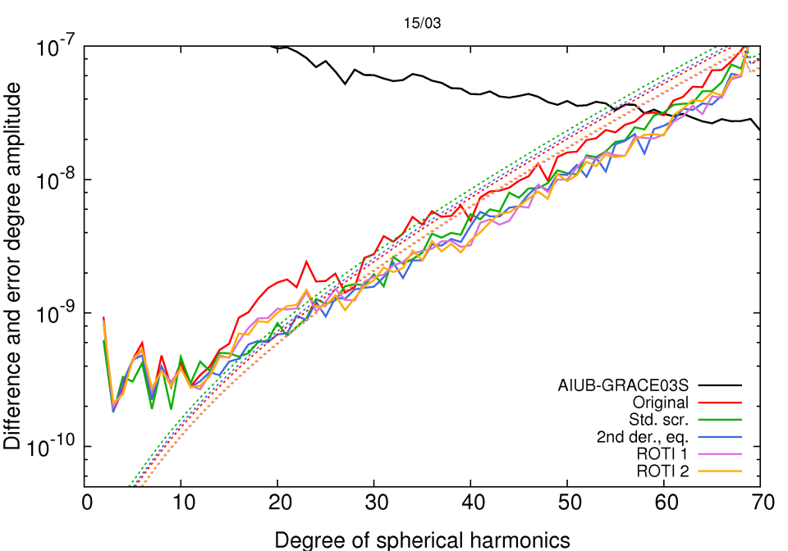
Results
March 2015: High ionospheric activity, prior to tracking loop update

Slide 11
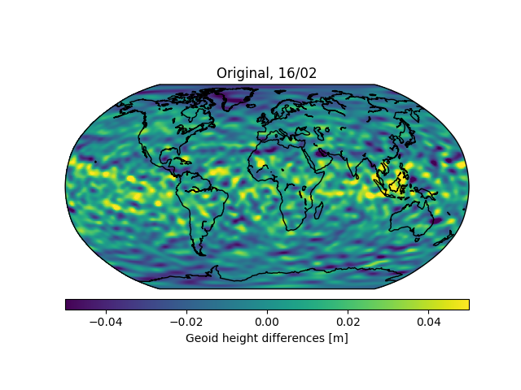
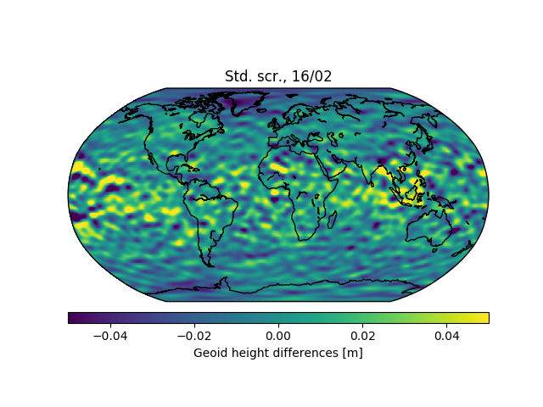
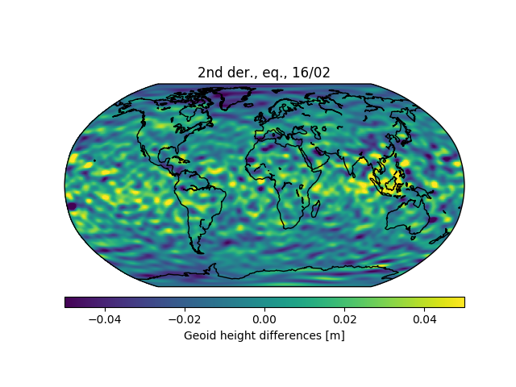
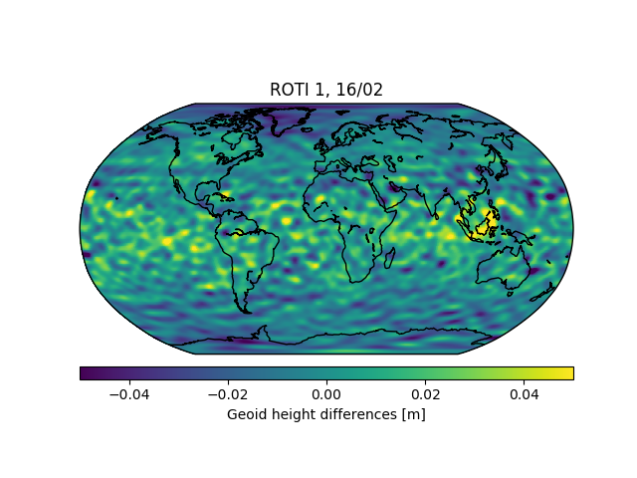

Results
February 2016: Intermediate ionospheric activity, after tracking loop update
Weighted RMS: 13.4mm
Weighted RMS: 14.5mm
Weighted RMS: 13.7mm
Weighted RMS: 11.4mm
Weighted RMS: 11.5mm

Slide 12
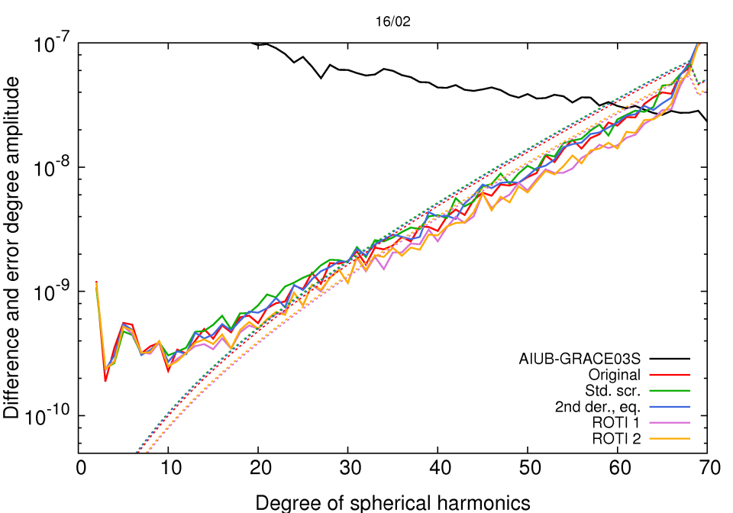
Results
February 2016: Intermediate ionospheric activity, after tracking loop update

Slide 13
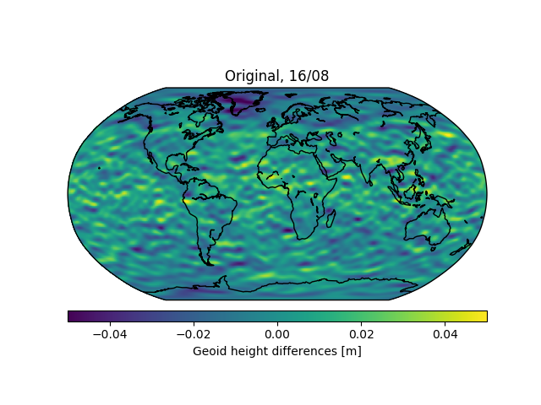




Results
August 2016: Low ionospheric activity, after tracking loop update
Weighted RMS: 9.3mm
Weighted RMS: 9.0mm
Weighted RMS: 9.1mm
Weighted RMS: 7.4mm
Weighted RMS: 7.5mm

Slide 14
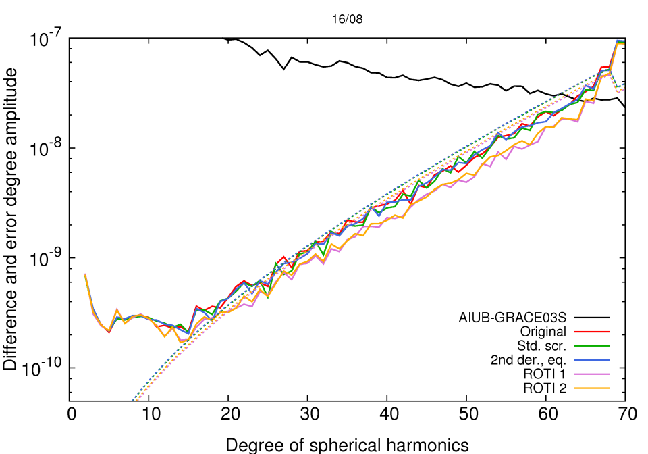
Results
August 2016: Low ionospheric activity, after tracking loop update

Slide 15
Results
SLR residuals for Swarm-A, March 2015
SLR residuals for Swarm-A, February 2016
SLR residuals for Swarm-A, August 2016
Test | Red.-dynamic |  | Kinematic
 | Mean (mm) | Std. dev. (mm) | Mean (mm) | Std. dev. (mm)
Original | 4.6 | 27.3 | 2.4 | 31.1
Std. screening | 3.7 | 26.9 | 0.7 | 31.4
 | 4.6 | 27.3 | 1.9 | 32.5
ROTI 1 | 4.9 | 26.5 | 1.0 | 28.8
ROTI 2 | 5.0 | 25.8 | 0.9 | 28.7
Test | Red.-dynamic |  | Kinematic
 | Mean (mm) | Std. dev. (mm) | Mean (mm) | Std. dev. (mm)
Original | 8.4 | 12.1 | 6.4 | 16.5
Std. screening | 8.1 | 13.1 | 6.3 | 22.9
 | 8.4 | 12.1 | 6.1 | 16.0
ROTI 1 | 8.5 | 12.5 | 5.7 | 15.4
ROTI 2 | 8.5 | 12.6 | 5.9 | 15.5
Test | Red.-dynamic |  | Kinematic
 | Mean (mm) | Std. dev. (mm) | Mean (mm) | Std. dev. (mm)
Original | 4.9 | 14.2 | 3.9 | 16.6
Std. screening | 5.0 | 14.3 | 3.9 | 16.7
 | 4.9 | 14.2 | 3.9 | 16.8
ROTI 1 | 4.7 | 14.7 | 3.8 | 17.0
ROTI 2 | 4.7 | 14.7 | 3.8 | 16.9
SLR observations of Graz, Greenbelt, Haleakala, Hartebeesthoek, Herstmonceux, Matera, Mount Stromlo, Potsdam, Wettzell (SOSW), Wettzell (WLRS), Yarragadee, and Zimmerwald, 20cm outlier threshold, 10°elevation cutoff.

Slide 16
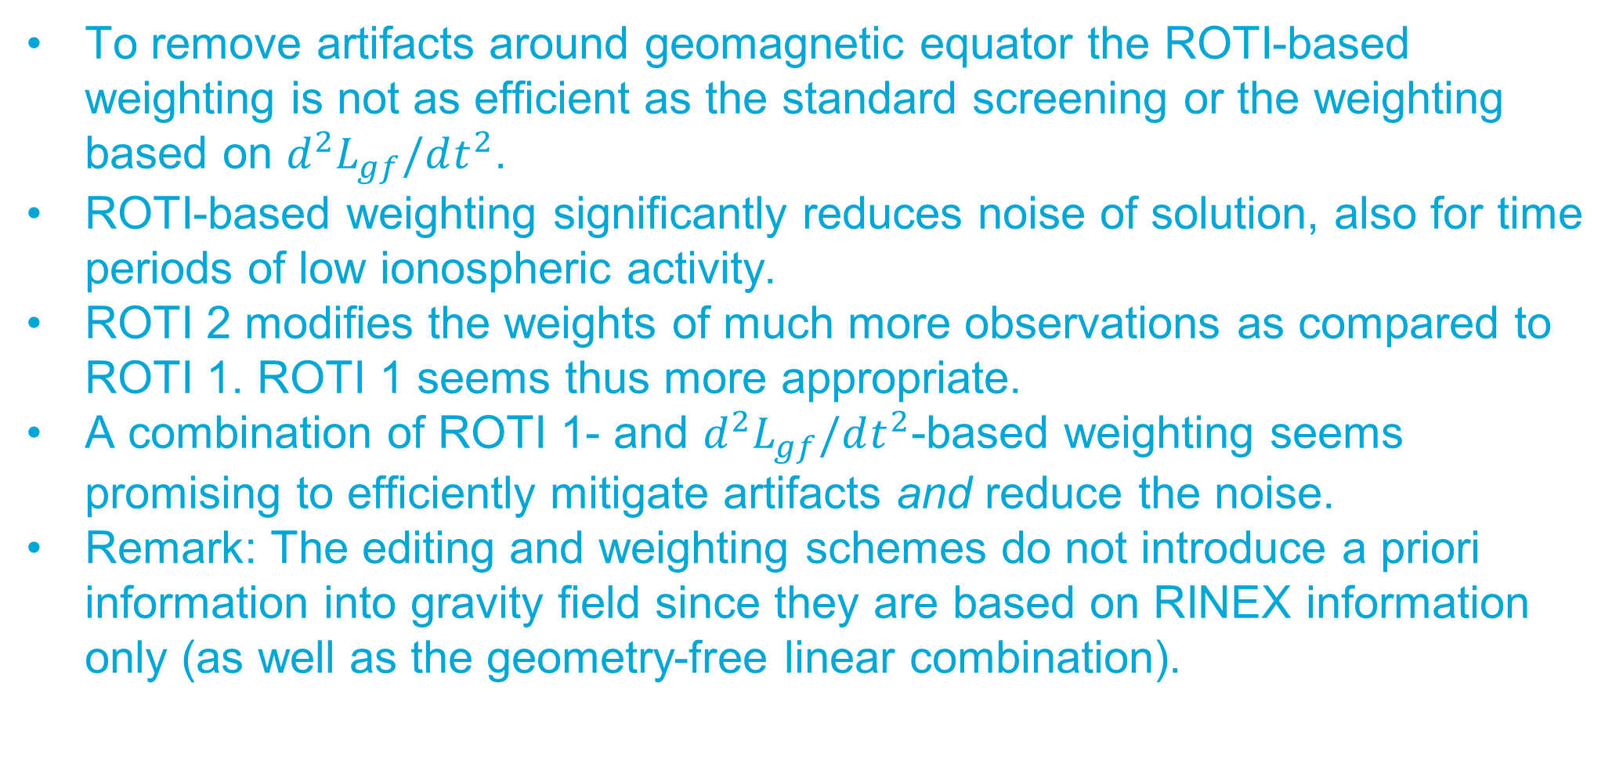
Conclusions
To remove artifacts around geomagnetic equator the ROTI-based weighting is not as efficient as the standard screening or the weighting based on $d^{2}L_{gf}/dt^{2}$.
ROTI-based weighting significantly reduces noise of solution, also for time periods of low ionospheric activity.
ROTI 2 modifies the weights of much more observations as compared to ROTI 1. ROTI 1 seems thus more appropriate.
A combination of ROTI 1- and $d^{2}L_{gf}/dt^{2}$-based weighting seems promising to efficiently mitigate artifacts and reduce the noise.
Remark: The editing and weighting schemes do not introduce a priori information into gravity field since they are based on RINEX information only (as well as the geometry-free linear combination).

Slide 17
WP220: Trade‐off between Swarm accelerometer data and non‐gravitational models
Aleš Bezděk
Astronomical Institute Ondřejov (ASU)
Mid Term Review
23 March 2018

Slide 18
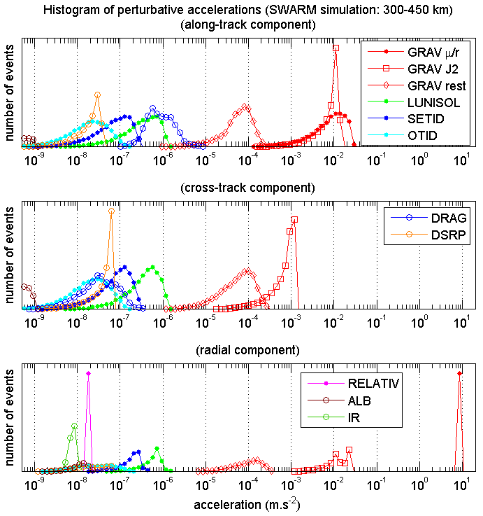
Forces acting on low-Earth satellites
Figure: Accelerations acting on Swarm
in along-track, cross-track, radial direction
Accelerations of gravitational origin
geopotential terms (GRAV)
other: lunisolar, tides, relativistic
Nongravitational accelerations (NG)
atmospheric drag + radiation pressures (direct solar, albedo, terrestrial infrared)
drag important for satellites in low Earth orbits (100–2000 km)
Gravity field recovery
estimated: GRAV
remaining terms:
modelled
measured/modelled

Slide 19
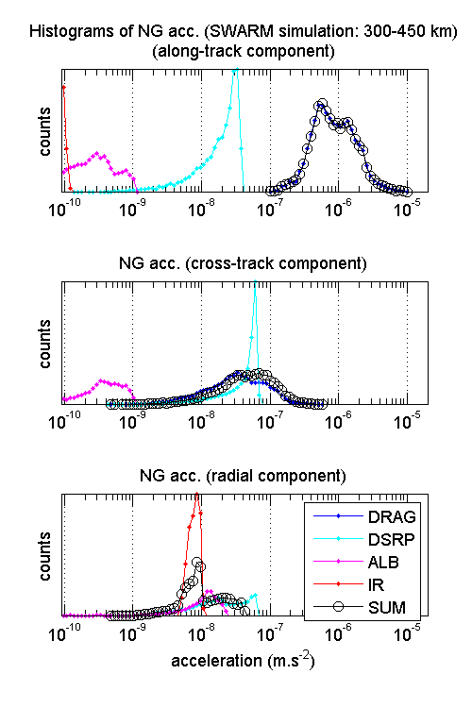
Space accelerometers
Designed to measure nongravitational accelerations
Aboard the gravity field satellites: CHAMP, GRACE, GOCE, Swarm
Magnitude of nongravitational accelerations:
Along-track: ≤ 10⁻⁵ m.s²
Cross-track: ≤ 10⁻⁶ m.s²
Radial: ≤ 10⁻⁷ m.s²
Along-track signal: the largest magnitude

Slide 20
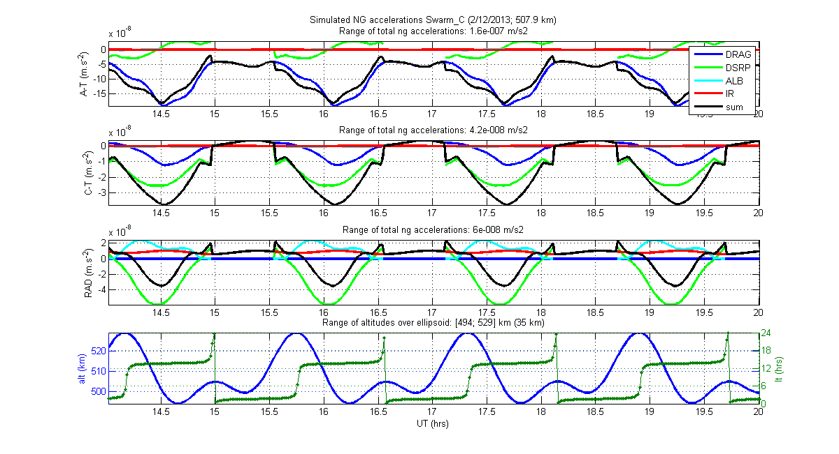
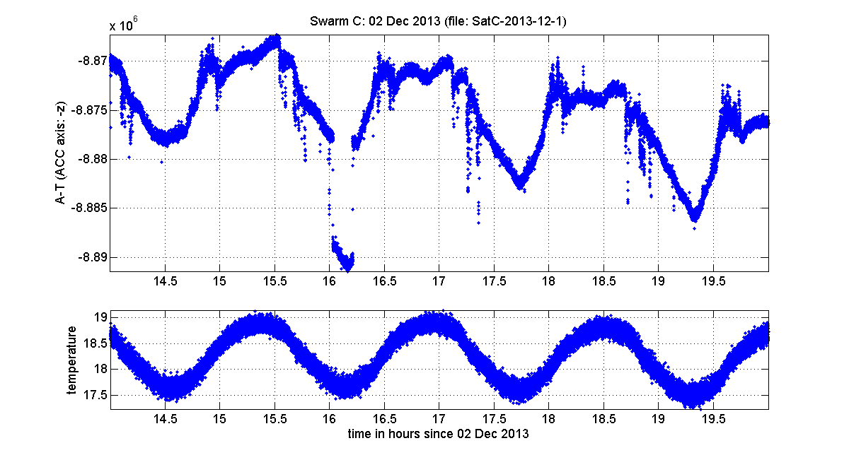
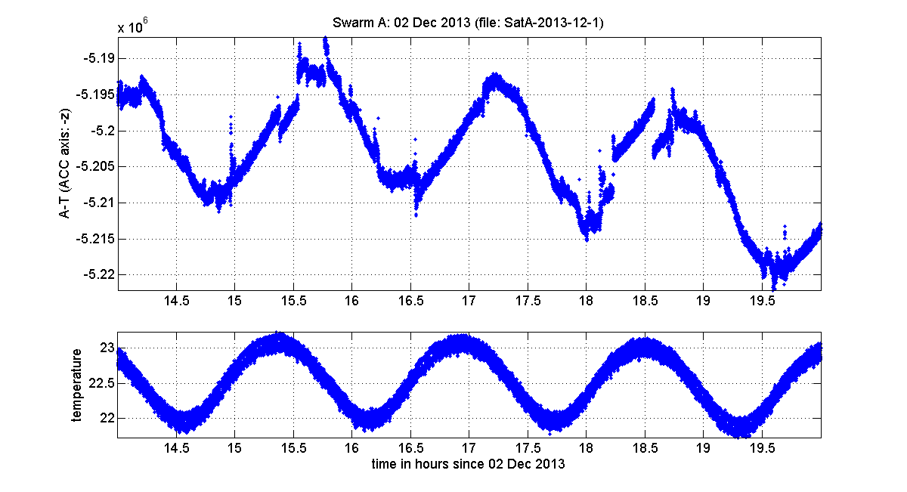
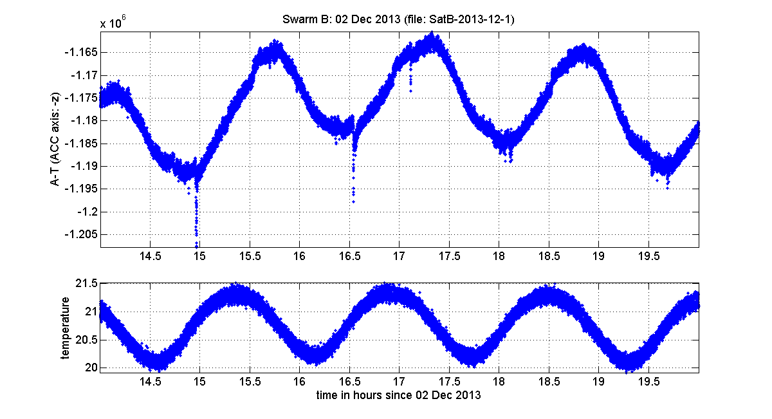
Swarm accelerometer data
Physical nongravitational (NG) signal
sum of atmospheric drag + radiation
variation due to altitude, local time etc.
characteristic steps at crossing the Earth shadow boundary (terminator)
Accelerometer (ACC) data of Swarm C
waveform of NG signal can be recognized, especially terminator crossings (in yellow)
Accelerometer data of Swarm A/B
temperature variation dominates
Notes:
ze leti vsechny tri druzice spolu, meli bychom videt prakticky totez
AT je o rad silnejsi, zamerime se na AT

Slide 21
WP220: Trade-off between Swarm accelerometer data and non-gravitational models
Expected output:
Recommendation on inclusion of measured or modelled non-gravitational accelerations in the production of the Swarm monthly gravity fields
Activities of WP220:
selecting a small number of test months
computing three types of gravity field models, each considering:
non-gravitational model of ASU (WP221),
non-gravitational model of TU Delft (WP222)
accelerometer measurements from Swarm-C (WP223)
analysing and interpreting the residual relative to GRACE

Slide 22
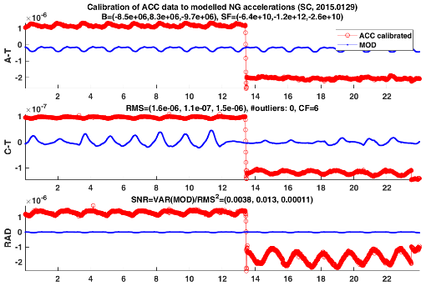
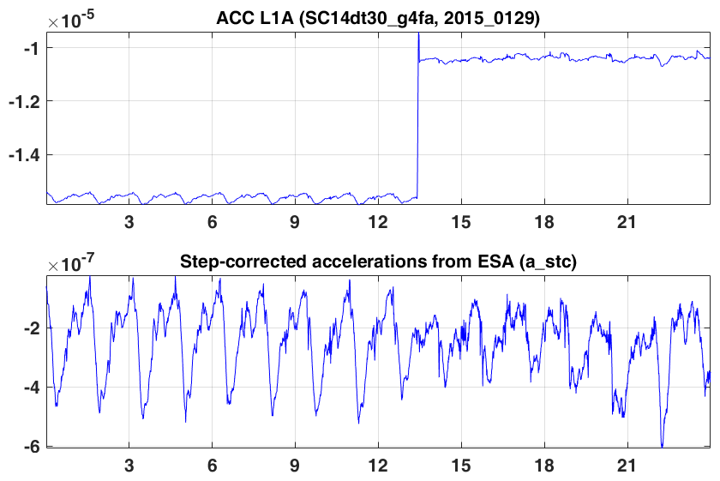
WP223: Measured non-gravitational accelerations
For Swarm-C accelerometer data
investigate the quality of cross-track and radial components for the their further use within this project
only along-track component is expected to be provided as the measured non-gravitational accelerations
Figure up:
Besides temperature dependence, ACC data affected by frequent hardware-related anomalies (jumps, spikes etc)
Figure bottom:
ESA developed step-corrective procedure
so far applied to along-track Swarm C acc data
Conclusions
step-corrected along-track ACC data of Swarm C usable
cross-track/radial ACC components not usable
affected by signal anomalies
cannot be calibrated, too low SNR

Slide 23
WP220: Selecting a small number of test months
availability of step-corrected along-track Swarm C accelerometer data
availability of the GRACE gravity field monthly solutions as a reference
varying accelerometer signal magnitude and variability
varying ionospheric activity
varying geomagnetic activity
Step-corrected along-track Swarm C accelerometer data
large number of abrupt signal changes (steps, jumps etc.) makes it difficult to use the Swarm ACC data for science
dedicated software tool developed by ESA to correct such anomalies (Siemes et al., 2016)
semi-automatic step correction, manual intervention of an operator is necessary
available only for selected periods of time
currently: Swarm C, along track, 19 Jul 2014 to 27 Apr 2016 (ACCxCAL_2 v. 0201)
Selected six test months:
January–March 2015
January–March 2016

Slide 24
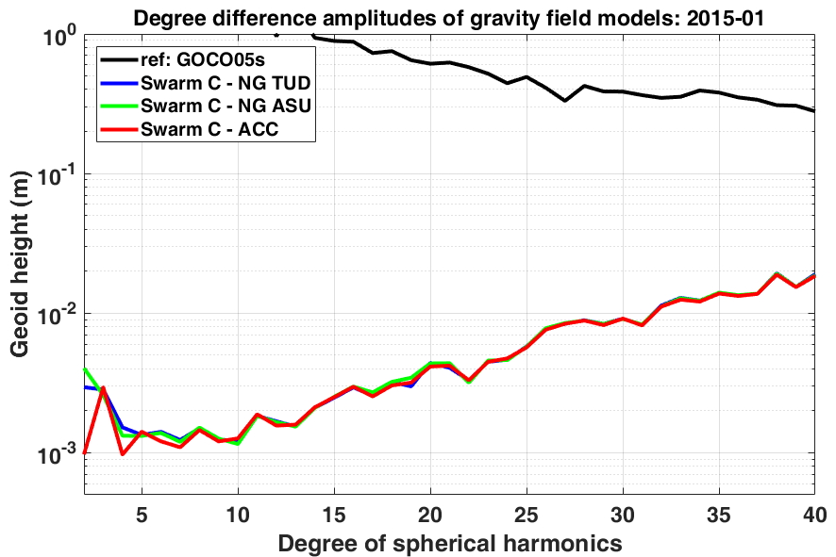
Gravity field solutions for Swarm-C in January 2015
Three gravity field solutions for Swarm-C
Along-track non-gravitational component:
TU Delft non-gravitational model
ASU non-gravitational model
calibrated ACC data
Using the ACC data improved the lowest degrees of the monthly gravity solution

Slide 25
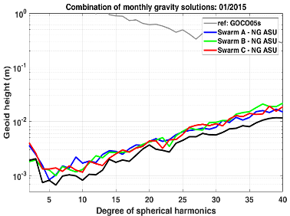
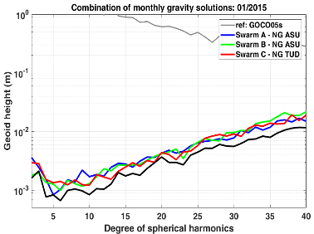
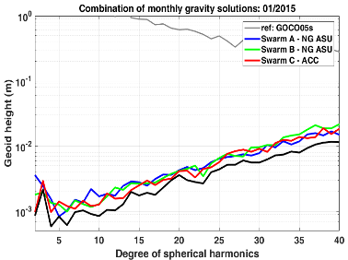
Gravity field solutions for Swarm in January 2015
combined gravity field solutions Swarm A+B+C
separate solutions for Swarm A/B/C & their combination (black)
Along-track non-gravitational component of Swarm C:
ASU non-gravitational model (NG ASU)
in lowest degrees, Swarm A/B/C solutions comparable
Along-track non-gravitational component of Swarm C:
TU Delft non-gravitational model (NG TUD)
in lowest degrees, Swarm A/B/C solutions comparable
Along-track non-gravitational component of Swarm C:
calibrated accelerometer data (ACC)
in lowest degrees, Swarm‑C field is better
increased weight Swarm‑C field in the combined solution

Slide 26
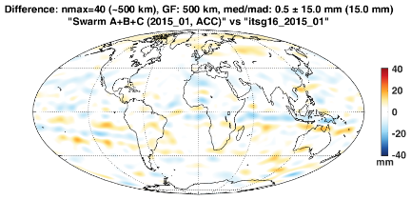
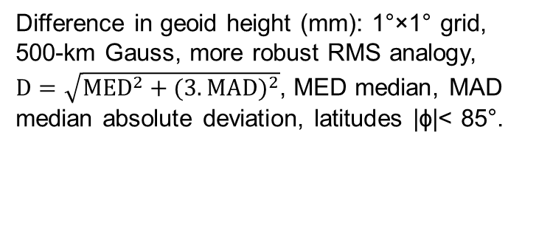
Reference: GRACE monthly gravity fields
 | KBR (ITSG-Grace2016)
 | NG ASU | NG TUD | ACC
1/2015 | 16.2 | 15.6 | 15.0
2/2015 | 18.8 | 18.0 | 17.9
3/2015 | 16.4 | 16.5 | 16.1
1/2016 | 20.3 | 20.0 | 20.5
2/2016 | 23.9 | 22.3 | 25.6
3/2016 | 17.1 | 15.6 | 18.5
Difference in geoid height (mm): 1°×1° grid, 500‑km Gauss, more robust RMS analogy, $D=\sqrt{{MED}^{2}+(3.{MAD)}^{2}}$, MED median, MAD median absolute deviation, latitudes |ϕ|< 85°.
Difference in geoid height between Swarm GPS-based gravity fields and the reference
indicator as a single number facilitating the comparison
Swarm GPS monthlies vs. standard GRACE KBR monthlies
reference: ITSG‑Grace2016 (similar results with UT CSR monthlies)
Jan-Mar 2015: gravity fields using ACC data better than those using NG models
Jan-Mar 2016: gravity fields using ACC data not better than those using NG models
Better ACC results obtained, when the magnitude of ACC signal is larger (i.e. in 2015)
11-year solar activity cycle is declining, minimum expected around 2019

Slide 27
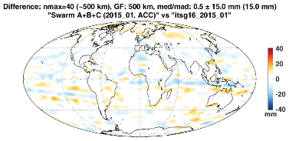
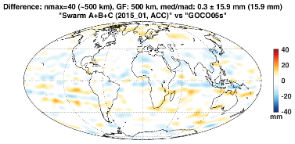
Reference: GOCO05s model
 | KBR (ITSG-Grace2016) |  |  | GOCO05s
 | NG ASU | NG TUD | ACC | NG ASU | NG TUD | ACC
1/2015 | 16.2 | 15.6 | 15.0 | 16.7 | 16.5 | 15.9
2/2015 | 18.8 | 18.0 | 17.9 | 18.0 | 17.7 | 17.5
3/2015 | 16.4 | 16.5 | 16.1 | 16.2 | 16.3 | 16.0
1/2016 | 20.3 | 20.0 | 20.5 | 17.5 | 17.3 | 17.3
2/2016 | 23.9 | 22.3 | 25.6 | 15.2 | 14.3 | 16.3
3/2016 | 17.1 | 15.6 | 18.5 | 12.5 | 12.4 | 12.9
Time-variable gravity field model GOCO05s
can be used as a proxy, when GRACE monthly fields are not available (after 2017)
Best match compared to other tested global time-varying models (e.g. Eigen6S).
Conclusions implied by KBR and those implied by GOCO05s are consistent
except for Jan 2016: let’s define that we accept ACC‑based gravity field as better, if its geoid height difference to GOCO05s is lower compared to that of the NG-based field

Slide 28
WP230 – Gravity field estimation with kinematic baselines
Mid Term Review
23 March 2018
N. Zehentner
Institute of Geodesy, Graz University of Technology

Slide 29
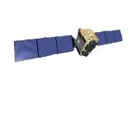
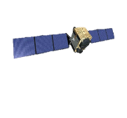
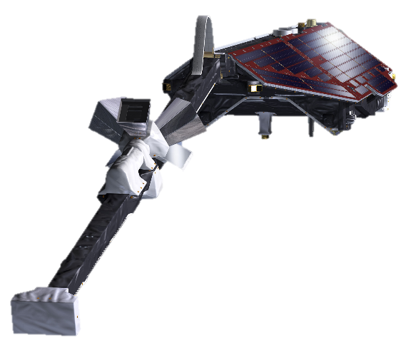
Introduction
Investigate the possible added value of kinematic baselines for the gravity field inversion
Baseline between Swarm A and C
Estimated from GNSS observations
High relative accuracy (few millimeters)
Common errors cancel out using double-differenced observations
Fixed ambiguities
GPS 01
GPS 02
30-180KM
Swarm A
Swarm C

Slide 30
Test setup
Selection of several test months
Criteria:
Grace monthly solution available for validation
Include months with high as well as low ionospheric activity
Include months with and without RINEX converter error
“bad” quality months: January and March 2015
“intermediate” quality months: February and March 2016
“good” quality months: June – August 2016
Kinematic orbits and baselines from TUD and AIUB

Slide 31
Gravity field inversion
Kinematic baselines converted to range observations (like Grace K-Band observations)
Kinematic orbits and derived range observations fed into the processing chain of the ITSG-Grace2016 solutions
Based on the variational equation approach
Basic facts:
Sampling 10s
Max D/O 60
Kinematic orbit and baselines of the same institute
3x3 Covariance information for kinematic orbits + empirical covariance function
Empricial covariance function for the range observations (no epoch covariance information)
Two solutions for each institute: with and without using the range observations

Slide 32
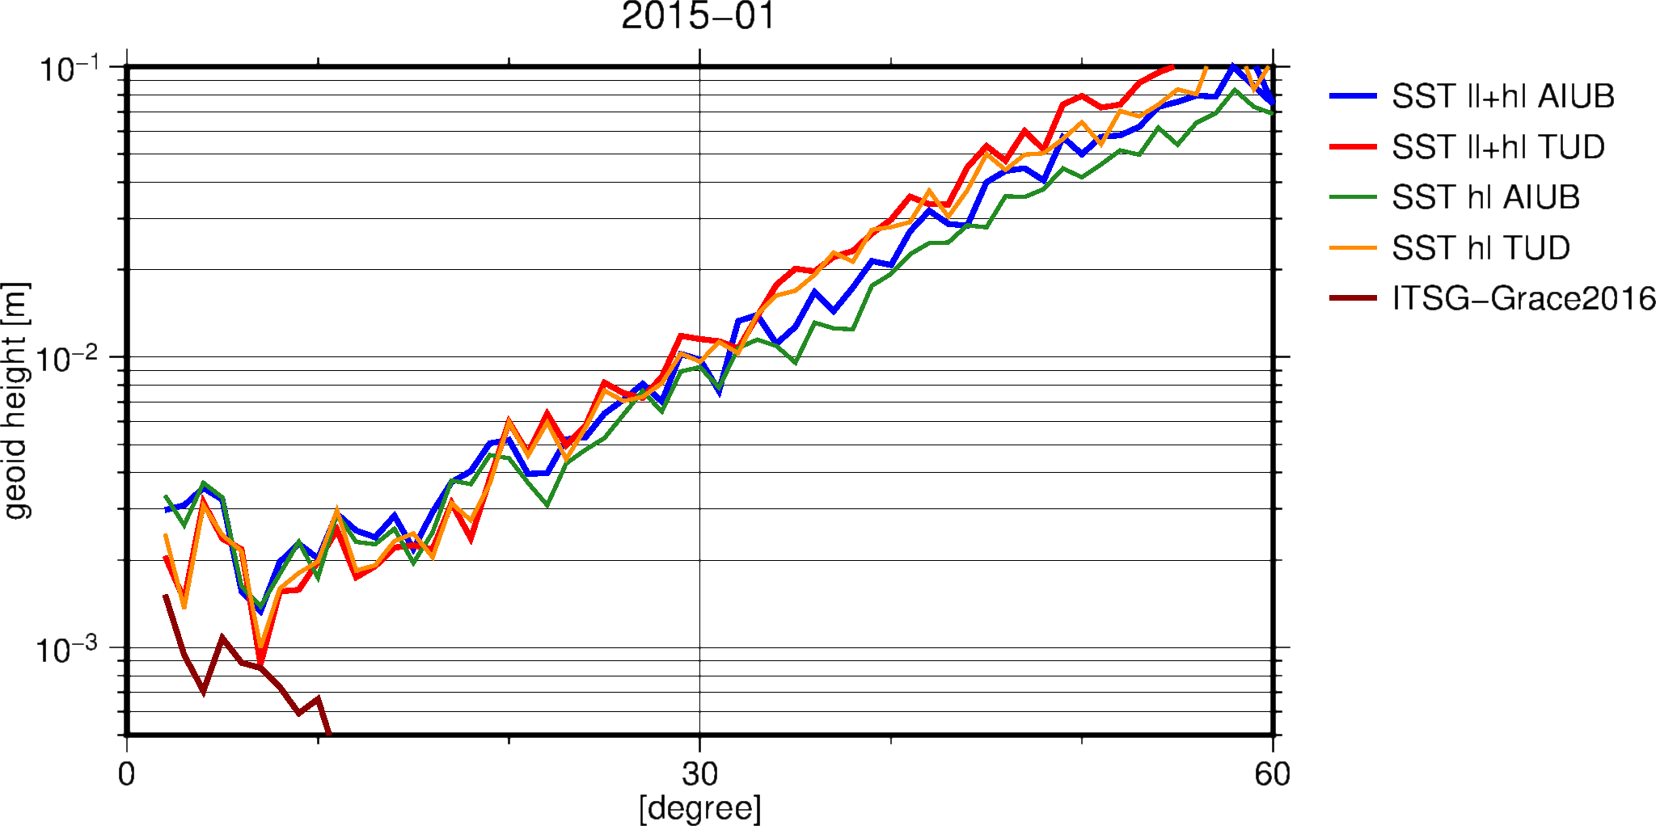
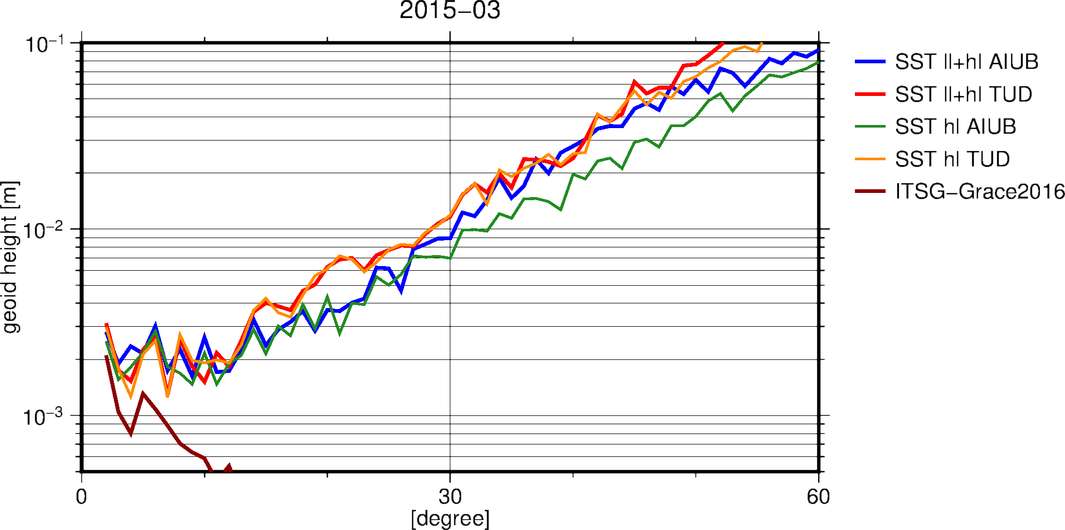
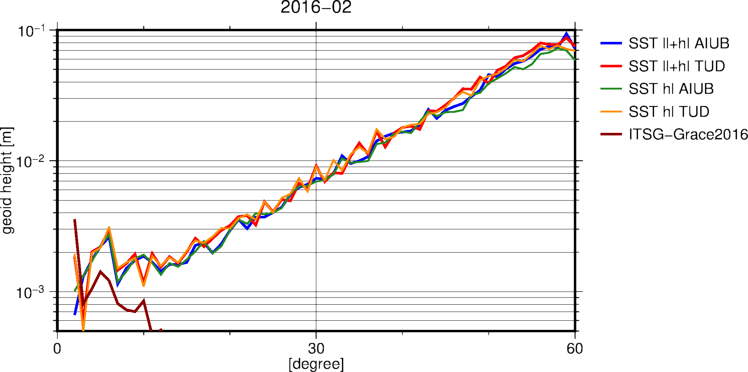
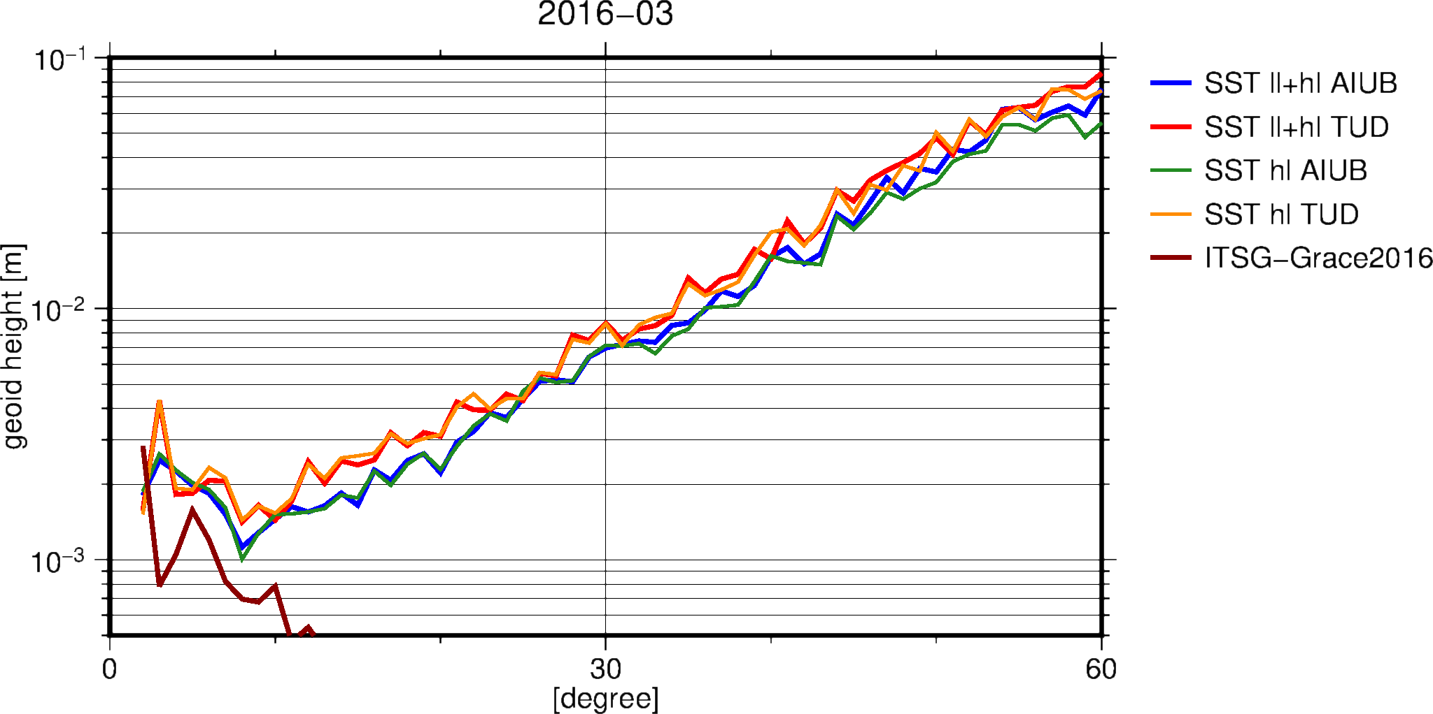
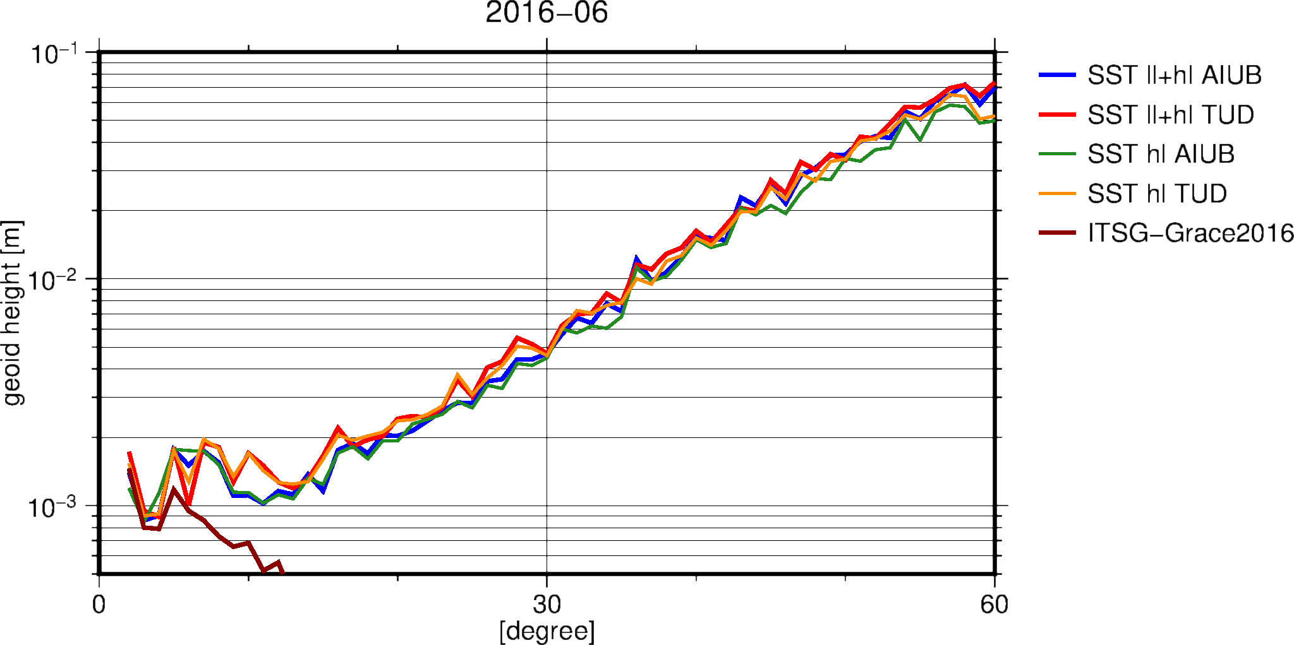
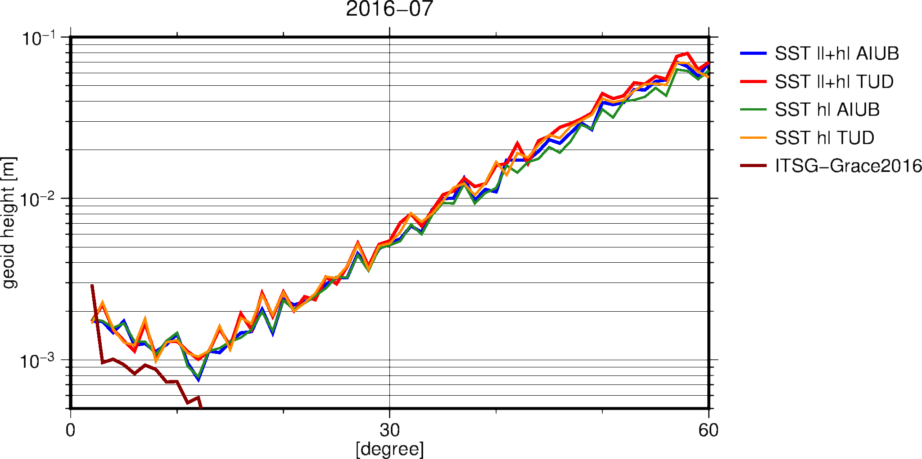
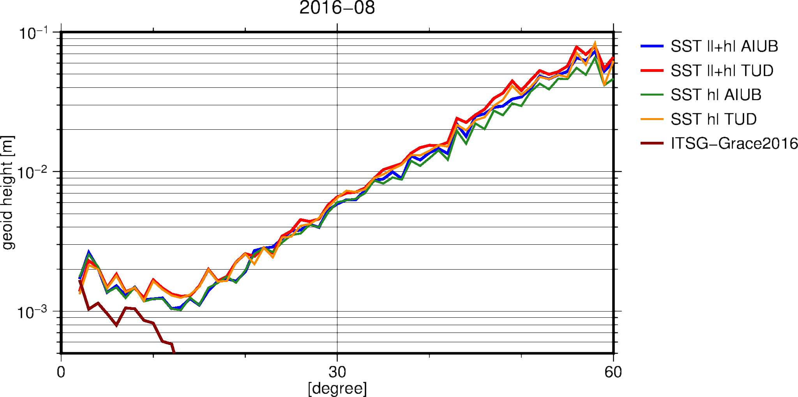
Results

Slide 33
Results
RMS of global 1ºx1º in geoid height difference with respect to ITSG-Grace2016 monthly solution. Filtered with 500km Gaussian filter.
 | TUD hl-SST [mm] | TUD ll+hl SST [mm] | AIUB hl-SST [mm] | AIUB ll+hl SST [mm]
January 2015 | 9.5 | 9.6 | 9.8 | 10.5
March 2015 | 10.9 | 11.1 | 8.4 | 9.6
February 2016 | 7.5 | 7.4 | 7.4 | 7.2
March 2016 | 8.8 | 8.6 | 7.3 | 7.3
June 2016 | 5.4 | 5.5 | 4.8 | 4.8
July 2016 | 6.7 | 6.5 | 6.3 | 6.1
August 2016 | 5.7 | 5.8 | 5.3 | 5.4

Slide 34
Conclusion
Including GNSS derived baselines into the gravity field inversion process does not result in an improved estimate compared to only using kinematic orbit information.
Reasons:
It is using the same information twice (the GNSS observations)
No additional information content in the baselines
Common errors are accurately modeled in the kinematic orbits
No epoch covariance information for the baselines
Possible cause for differences in high degrees for some months
Results will be presented at EGU2018 (poster)

Slide 35
WP500 Publication and presentation of project results (TU Delft)
Conference contributions
EGU Vienna, April 2018: 3 abstracts
COSPAR Pasadena, July 2018: 1 abstract
Paper
Template prepared for Earth Planets Space
Introduction DRAFT

